Slide 1
DIGITAL PORTFOLIO
STUDENT NAME: Gokul S
REGISTER NO & NMID: 212400935 /FC2378B8589ED12A20E49F5483A22D62
DEPARTMENT: II BCA
COLLEGE: Prince Shri Venkateshwara Arts and Science College / Madras
university.

Slide 2
Project Title
📌 Digital Portfolio

Slide 3
Agenda
Problem Statement
Project Overview
Target Users
Tools & Technologies
Portfolio Layout & Design
Features & Highlights
Results & Demonstrations
Conclusion
GitHub Repository

Slide 4
Problem Statement
Resumes and CVs often fail to demonstrate creativity and technical skills.
Many students face difficulty showcasing projects effectively.
A professional online space can help present skills in a structured way.
A digital portfolio provides visibility and helps in building personal branding.

Slide 5
Project Overview
A modern portfolio website designed to:
Highlight academic records and certifications
Showcase technical abilities
Present completed projects with details
Provide contact and networking options
Focused on responsive design and easy accessibility.
Acts as a bridge between students and recruiters.

Slide 6
Who Are the End Users?
Hiring Managers & Recruiters – Quick skill evaluation.
Employers – Selecting candidates for roles.
Educational Institutes – For internships and project reviews.
Peers – For collaboration and networking.
Clients – To check professional competence before hiring.

Slide 7
Tools & Technologies
Frontend – HTML, CSS, JavaScript
Frameworks – Bootstrap / Tailwind CSS
Version Control – Git, GitHub
Design Principle – Responsive & User-Centered Design
Extras – Simple animations and icons for better UI

Slide 8
Portfolio Design & Layout
Sections included:
About Me – Career goals and personal summary
Skills – Technical expertise and software knowledge
Projects – Case studies with descriptions & images
Contact Me – Email, LinkedIn, GitHub
Design Highlights:
Consistent and professional theme
Smooth transitions and user-friendly navigation
Optimized for all screen sizes

Slide 9
Features & Highlights
Responsive design for all devices
Interactive project showcase
Smooth menu navigation
Contact form & social media links
Easy customization for updates
Simple UI for better user experience

Slide 10
& Demonstrations
Successfully created a personal website portfolio
Provides an interactive way to highlight skills
Helps in career development and visibility
Screenshotsof different sections included (About, Skills, Projects, Contact)

Slide 11
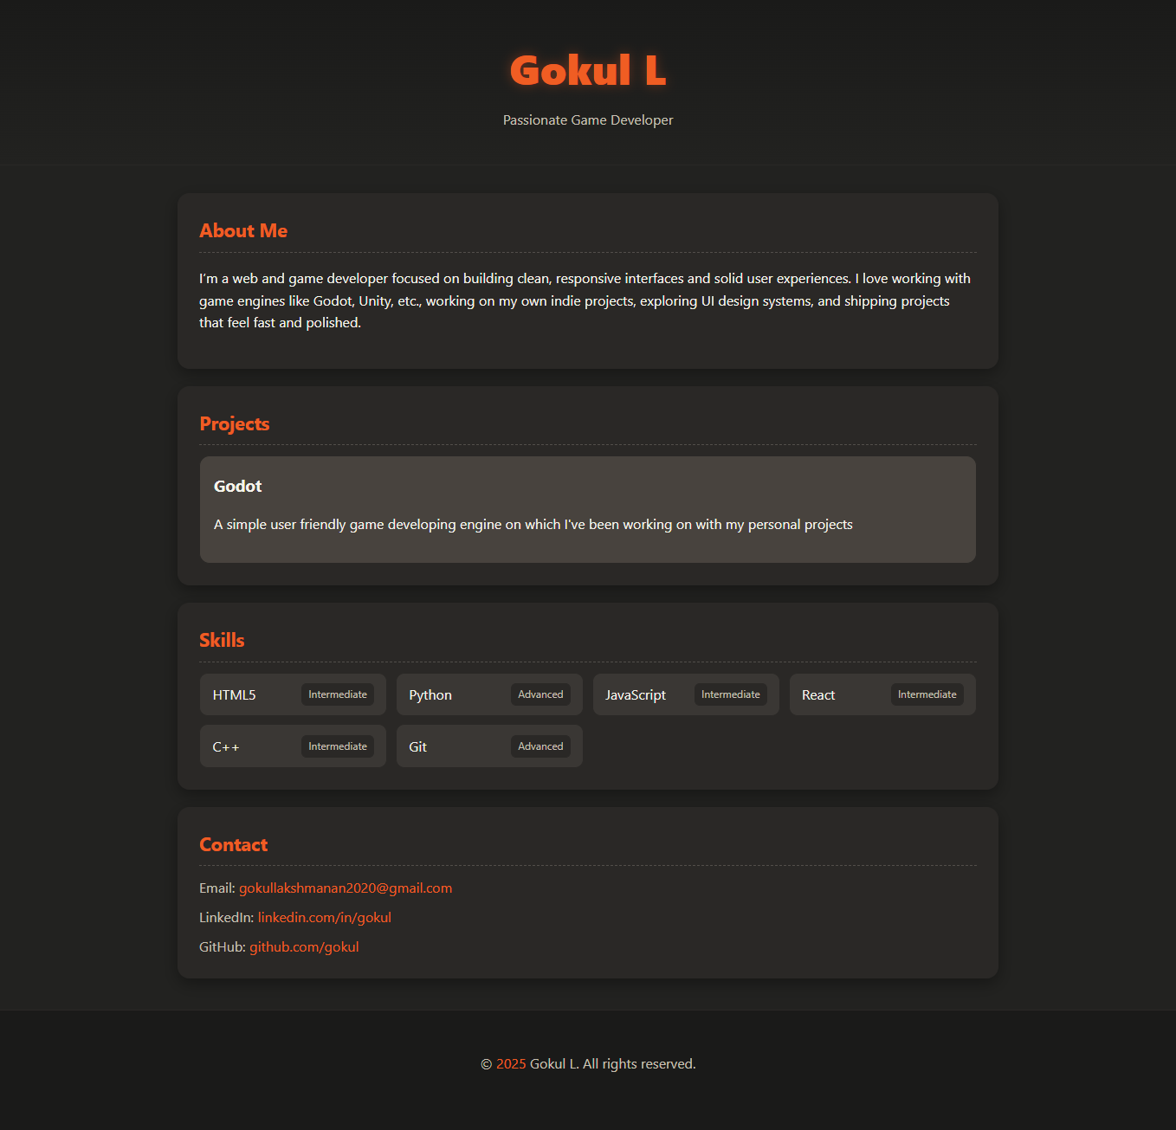
Results and screenshot

Slide 12
GitHub Link
https://gokullakshmanan2020-max.github.io/My-portfolio/

